Slide 1

The Battle of the Neighborhods
Applied Data Science Capstone Project

Slide 2
Introduction
Singapore is a sovereign island city-state in South-East Asia. It is one of the smallest countries in the world with a total land area of 730 square kilometres. Although with its small country size, the population of Singapore is about 5.7 million, making it one of the highest population densities in the world.
Due to its favourable geographical position, Singapore is a major international transport hub in Asia, serving some of the busiest sea and air trade routes.
Due to these factors, millions of passengers and cargo, both via air and sea, pass through Singapore annually. This explains why Singapore is also one of the business hubs in the region. Because of these factors, Singapore attracts people of diverse background for work, study and play.
For this, it becomes a melting pot of different cultures from the people that visit and work here. In this project, we will try to explore and list the different types of restaurants that serve international cuisines in Singapore.

Slide 3
Problem
To explore the neighbourhood in Singapore to answer the following questions:
To find out the Thai and Korean restaurants in Singapore.
The best rated Thai and Korean restaurant in Singapore to recommend for a Korean or a Thai visiting Singapore.
If a businessman is interested to open a Thai or a Korean restaurant in Singapore, which part of Singapore will be the best place to attract diners?
What type of venues are the most popular in the neighbourhoods of Singapore?

Slide 4
Data to be used
For this project, we will be using the following data.
List of neighborhoods in Singapore with location coordinates (latitudes and longitudes).
Source: After some exploration of the correct data to use for getting the accurate snapshot of the neighborhoods of Singapore, we found the subzones to be more relevant for our analysis. The information of the subzones can be found from the following link [https://data.gov.sg/dataset/resident-population-by-planning-area-subzone-and-type-of-dwelling-2015]. The data is in csv format which is downloaded for analysis.
List of nearby venues in these neighborhoods from FourSquare API.
Source: Foursquare API

Slide 5
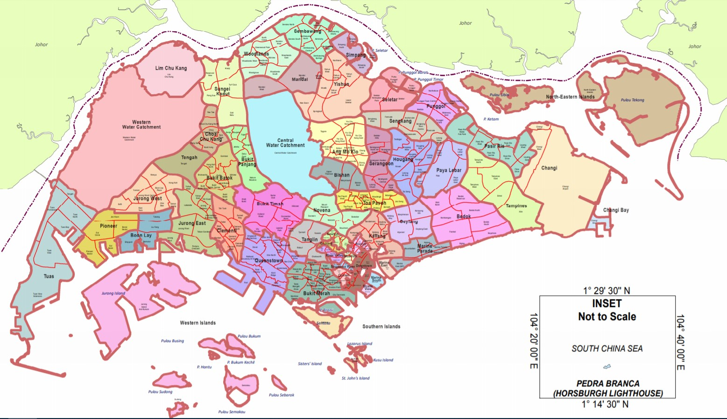
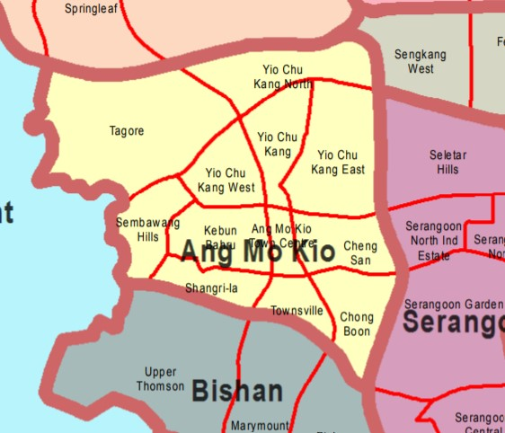
Planning Areas and Subzones of Singapore

Slide 6
Methodology
First, we will download the planning areas and subzones data from Open Data Singapore link.
We will process the csv data into a Pandas dataframe and remove the unnecessary columns not required in our analysis.
We will call Nominatim inside Geopy library to retrieve the location coordinates of the neighborhoods.
We will find all available venues for each neighborhood using FourSquare API.
We will then filter out the Korean and Thai restaurant venues.
With FourSquare API, we will retrieve the ratings, tips and likes count for the Korean and Thai restaurants.
We will go back to the neighborhoods and sort the dataframe by population count and find out which location is best to open a Korean or Thai restaurant to capture the customers.
We will go back to the retrieved venues for each neighborhood and do a pivot table to see what are the most popular venue in each neighborhood.

Slide 7
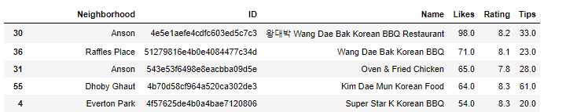
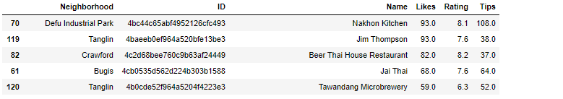
Conclusions
Most Popular Korean and Thai restaurants.
Recommend to open a Korean restaurant in the Northern or Eastern region as there might have lesser competition there and able to capture more residential population.
Comparing Korean and Thai restaurant count, it seems that there are more Thai restaurants as compared to Korean restaurants in Singapore.
The top 5 most popular venues in Singapore are mostly F&B outlets [Food and Beverages]

